Slide 1
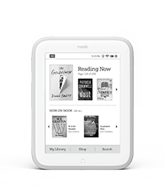
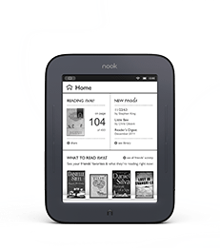
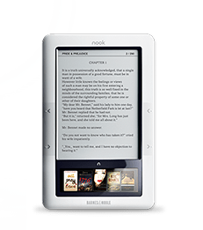
How to Get a Library eBook on Your Nook eReader (black & white)
Prepared by the Computer Lab
Montgomery County-Norristown Public Library
Revised: 12/16/2015

Slide 2
Supported Devices
This tutorial applies to Nook eReaders—devices with black and white, e-ink screens. This includes:
Nook 1st edition
Simple Touch
Simple Touch with GlowLight
Patrons have reported issues getting library books to open on the GlowLight Plus model. It may work for one or two library books, but after that, it may stop working.
Your mileage may vary.
Also note that, the GlowLight and GlowLight Plus models are not listed on Adobe Digital Edition’s list of supported devices. This means that you may not be able to read library books on these devices.
List of supported devices:
http://blogs.adobe.com/digitalpublishing/supported-devices

Slide 3
Overview of Basic Steps
Download Adobe Digital Editions software onto your computer and authorize the computer with an Adobe ID. For instructions on how to do this, see the tutorial named “How to Download Adobe Digital Editions and Get an Adobe ID”.
Search for an eBook in the library’s digital collection at OverDrive
Check out the eBook and download it to your computer
Use Adobe Digital Editions to transfer the eBook from your computer to your eReader (Note: If you have a Nook Glowlight Plus, you will need to use Windows Explorer to copy it).

Slide 4
What Will I Need?
A library card based on a residency in Montgomery County.
A computer or laptop that has been authorized with an Adobe ID. For instructions on how to do this, see the tutorial named “How to Download Adobe Digital Editions and Get an Adobe ID”.
Access to the Internet.
Your Nook device and the USB cable to connect it to your computer.

Slide 5
Policies and tips to bear in mind
Borrowing period Can be set to 7, 14 or 21 days in the settings page on the OverDrive website. The default setting is 14 days.
Borrowing limits 10 items can be borrowed at one time (audio and eBooks combined).
Renewing an eBook eBooks cannot be renewed. However, they can be checked out again if not on reserve by another patron.
Reserving an eBook 10 items can be put on hold at one time (audio and eBooks combined). Once an item becomes available, you must check it out within 72 hours.
Late Fees None. eBooks are automatically returned when their loan period expires.

Slide 6
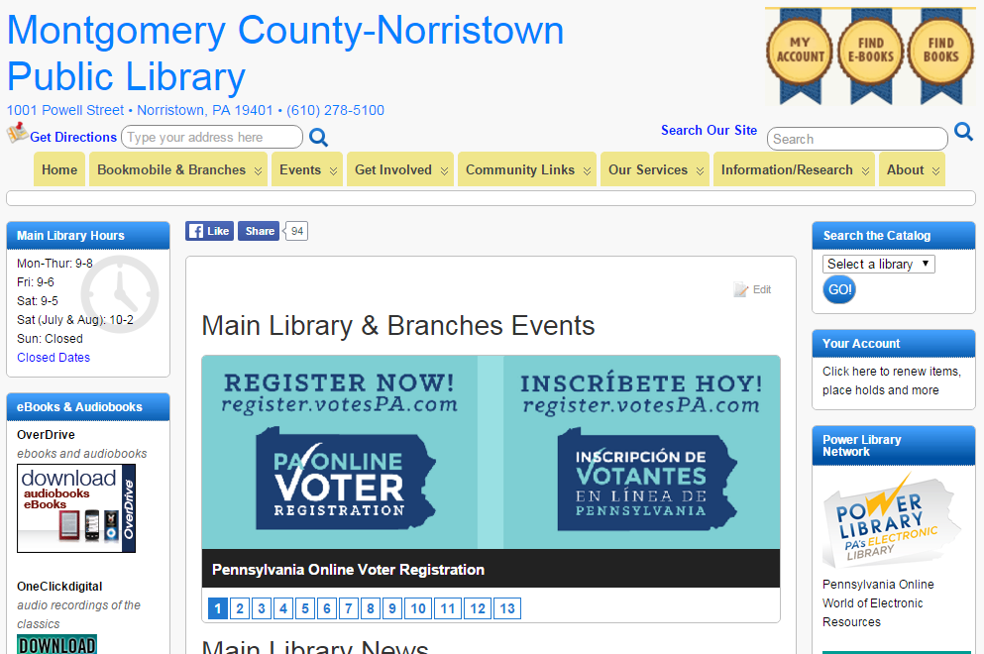
Finding and Checking Out an eBook
On your computer, go to www.mc-npl.org and click on the link to download audiobooks/eBooks.

Slide 7
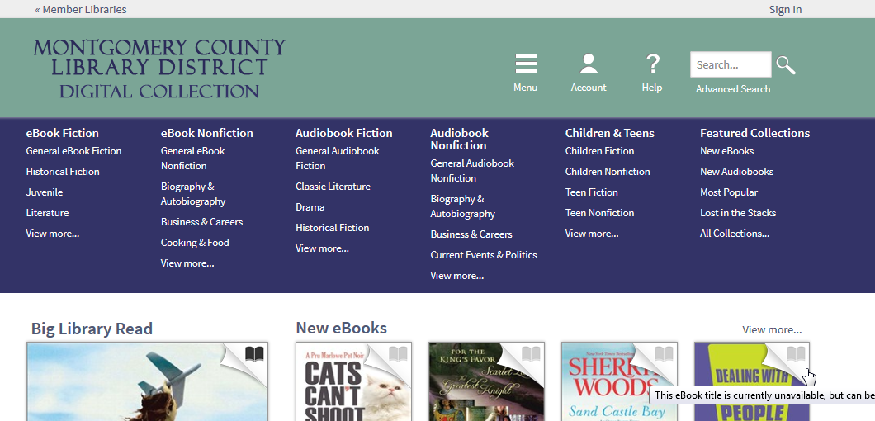
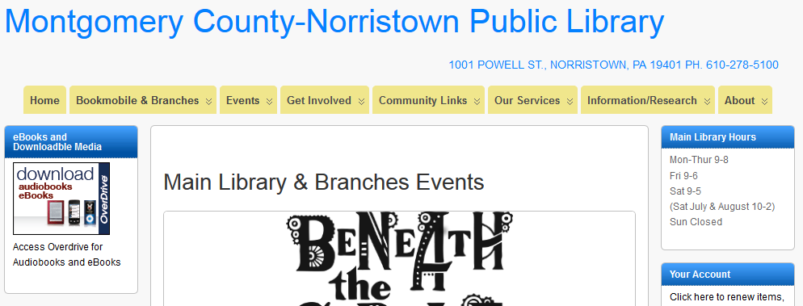
Finding and Checking Out an eBook
You will arrive at the OverDrive website. OverDrive manages the digital collection for the Montgomery County Library District. As soon as you get there you should sign in by clicking the words “Sign In” in the top-right corner of the screen.

Slide 8
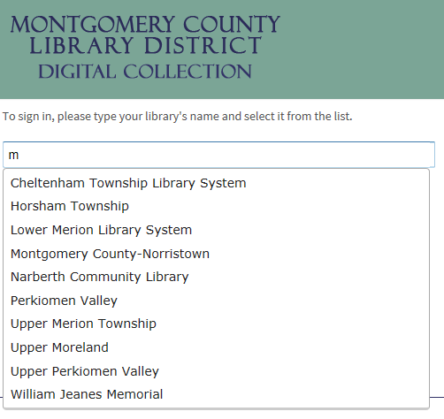
Finding and Checking Out an eBook
It first asks you for the name of your home library. Your home library is not necessarily the library you visit the most, but the library that serves the area where you live.
As soon as you start typing, a list of suggestions will appear.
Select your home library from the list by clicking on it.
Refine search

Slide 9
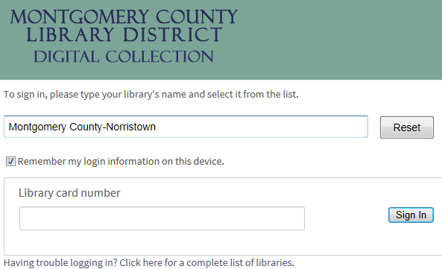
Finding and Checking Out an eBook
Next, enter your library barcode number and then click “Sign In”.
Refine search

Slide 10
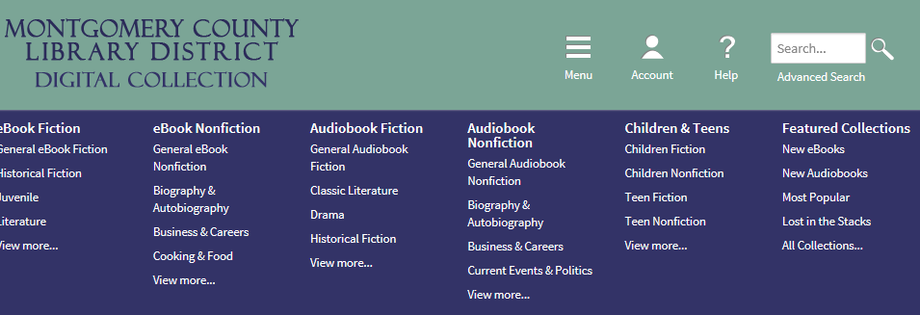
Finding and Checking Out an eBook
We are going to search for a book by a particular author. To begin, click on “Advanced Search”.
Refine search

Slide 11
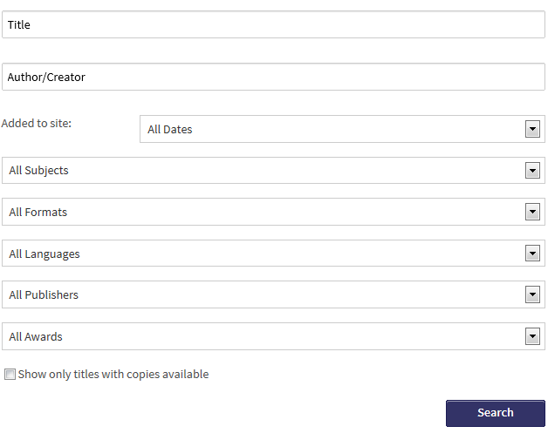
Finding and Checking Out an eBook
This is the Advanced Search form. We will be searching for a book by Stephen King. Enter his name in the “Author/Creator” field.
Refine search

Slide 12
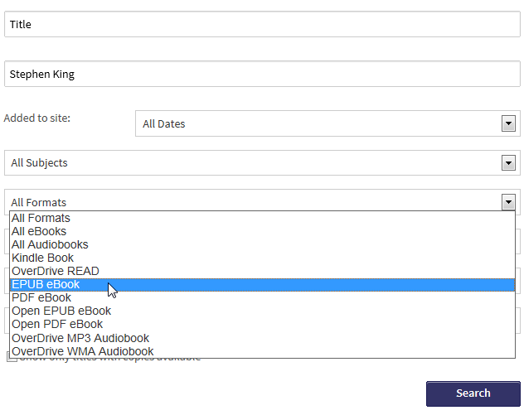
Finding and Checking Out an eBook
Next we’ll select a format. “EPUB eBook” is a format that you can read on Nook devices. (“Open EPUB eBook” and “PDF eBook” can be read also but there are more EPUBs in the collection)
Refine search

Slide 13
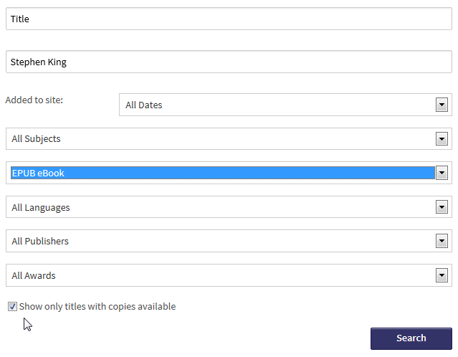
Finding and Checking Out an eBook
Finally, we’ll look for titles that can be checked out immediately. Click on the “Show only titles with copies available” box. Finally, click the “Search” button.

Slide 14
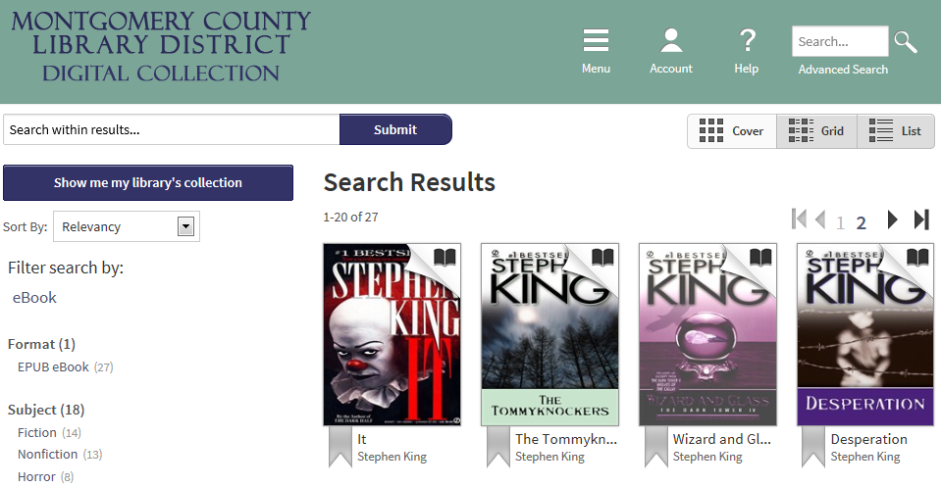
Finding and Checking Out an eBook
We’re going to borrow “It”. Click on the book cover.
Refine search

Slide 15
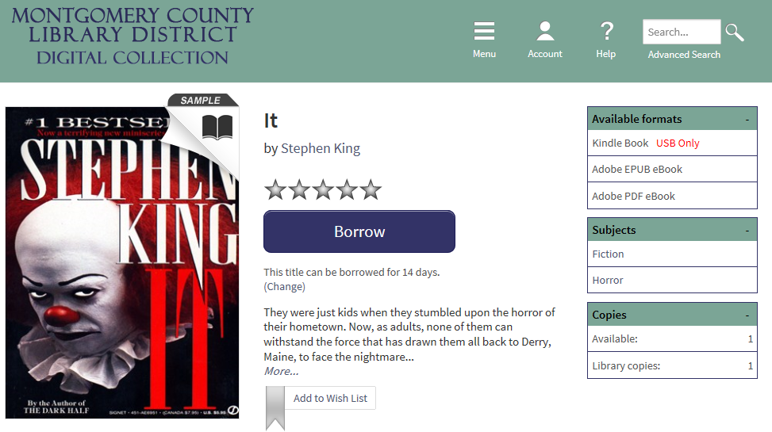
Finding and Checking Out an eBook
The book is available in formats other than EPUB. We’ll have to choose a format when we download it. Click the “Borrow” button.
Refine search
Notes:
Look for this advanced search box on OverDrive page (left side) -this allows you to refine your search
Refine your search
we’re going to search by Stephen King only
we’re going to refine the format to search for EPUBS
we’re going to look for only copies that are available for immediate checkout

Slide 16
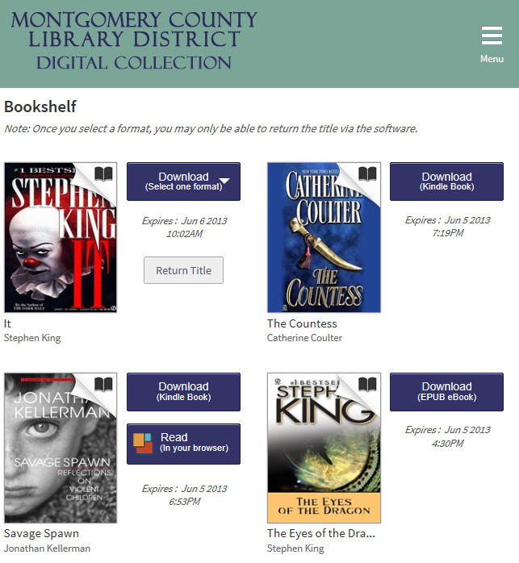
Downloading your eBook
Once the Borrow button is clicked you are taken to your OverDrive bookshelf. Our book is there plus some others we borrowed as well.
We need to select a format to Download. Click on the “Download” button.
Refine search

Slide 17
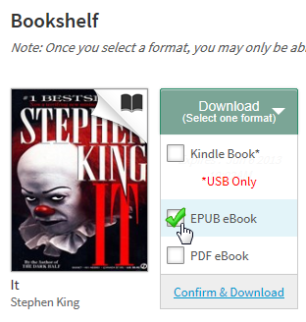
Downloading your eBook
Click on the “EPUB eBook” format and then click “Confirm & Download”.
Refine search

Slide 18
Downloading your eBook
Depending on which internet browser you are using, you may be prompted to open or save the book file. Always choose “Open”.

Slide 19
Transferring your eBook to your Nook device
Your book will automatically open in the Adobe Digital Editions software on your computer. To transfer it to your Nook device, click on the “Library” button.

Slide 20
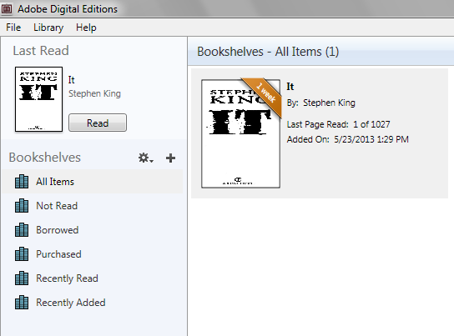
Transferring your eBook to your Nook device
This is the Library view. You can see various Bookshelves on the left and on the right you can see your book on the All Items bookshelf.

Slide 21
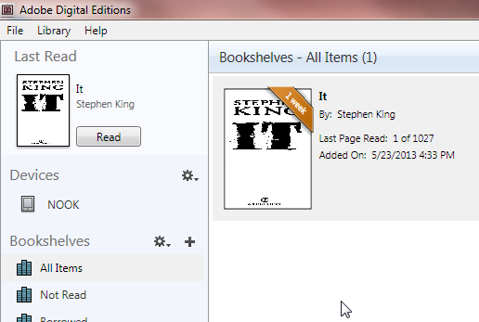
Transferring your eBook to your Nook device
Turn on your Reader and, using the USB cord, plug it into the USB port on your computer, and wait a few moments.
If you see your device listed on the left side of the screen, continue to the next slide. If you do not see your device, skip to the “Transferring your eBook to your Nook device using Windows Explorer” section of this tutorial.

Slide 22
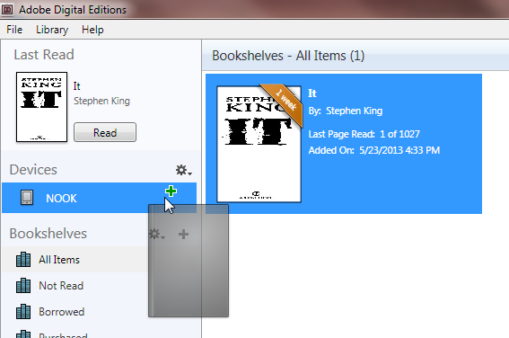
Transferring your eBook to your Nook device using Adobe Digital Editions
Click and drag the book jacket over towards the “Nook” entry on the left side of the screen. When you are pointing correctly to the Nook entry you will see a green +. You can then let go.

Slide 23
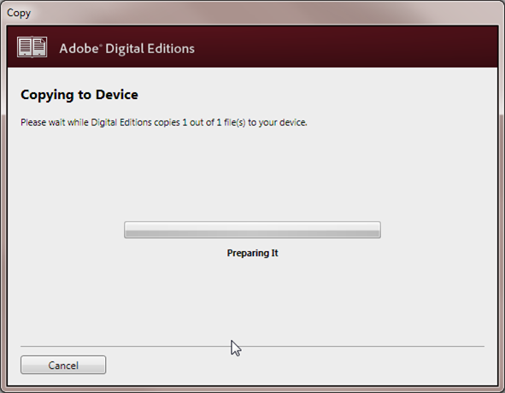
Transferring your eBook to your Nook device using Adobe Digital Editions
You may see a notification like this:

Slide 24
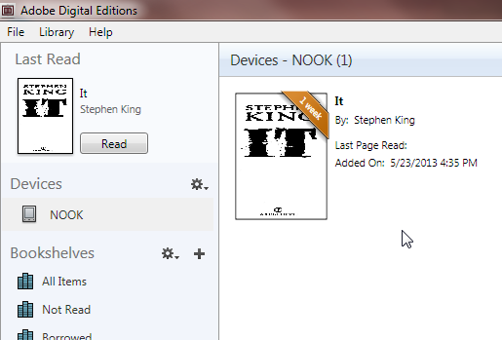
Transferring your eBook to your Nook device using Adobe Digital Editions
Click on the entry for your Nook device on the left side of the screen. Notice how your book has been transferred to your Reader.

Slide 25
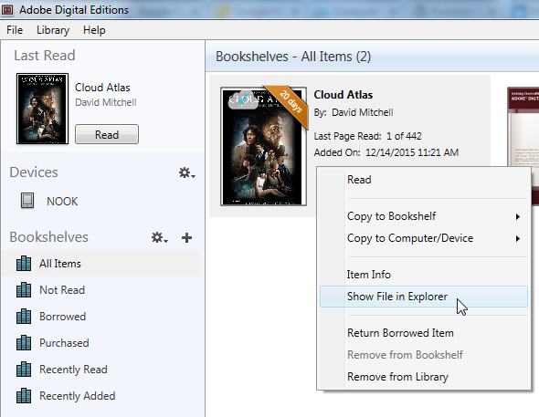
Transferring your eBook to your Nook device using Windows Explorer
If you have already transferred your eBook to your device using the previous instructions, you can skip to the “Safely Eject Your Reader” section of this tutorial.
Adobe Digital Editions does not recognize certain Nook models. To copy eBooks to these devices, you will have to use Windows Explorer.
Right-click on the on the book jacket and select “Show File in Explorer”.

Slide 26
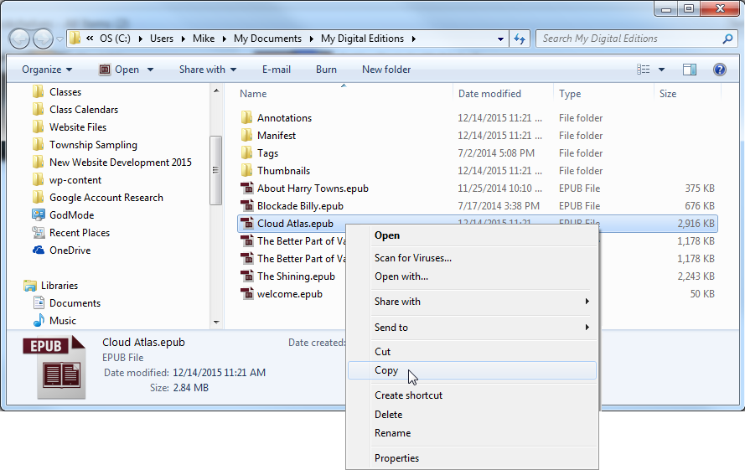
Transferring your eBook to your Nook device using Windows Explorer
A Windows Explorer window will appear. Your book should be selected (highlighted in blue). Right-click on your book and select “Copy” from the context menu.

Slide 27
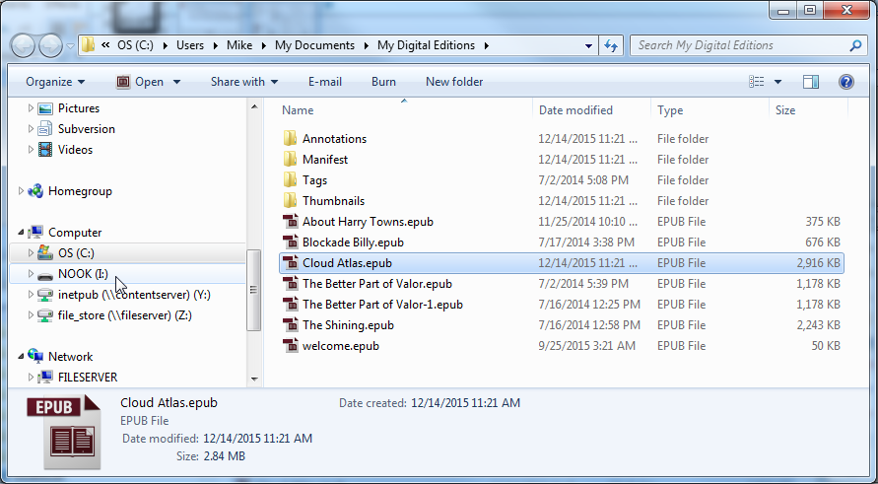
Transferring your eBook to your Nook device using Windows Explorer
Find the entry for your Nook device in the pane on the left side of the window. Note: You may have to use the scrollbar to see it.

Slide 28
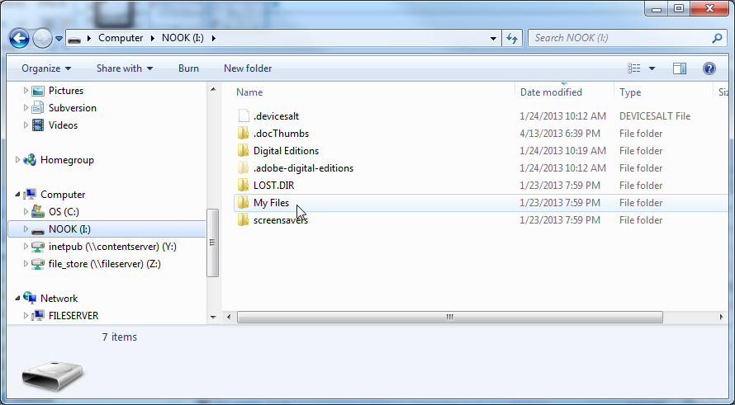
Transferring your eBook to your Nook device using Windows Explorer
Click on the entry for your Nook device. The contents of your Nook device is displayed on the right. Then, double-click on “My Files”.

Slide 29
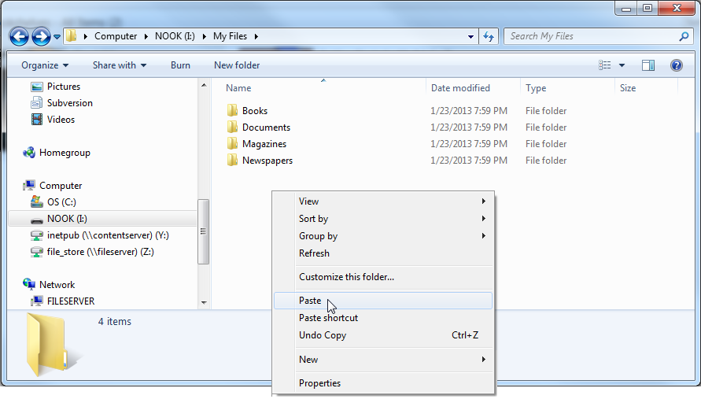
Transferring your eBook to your Nook device using Windows Explorer
Right-click in a clear area underneath the existing files and select “Paste” from the context menu.

Slide 30
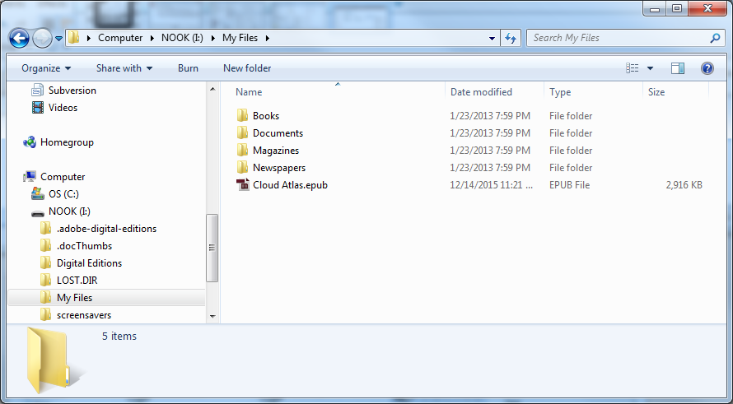
Transferring your eBook to your Nook device using Windows Explorer
After a few seconds, the book will appear in the file listing.

Slide 31
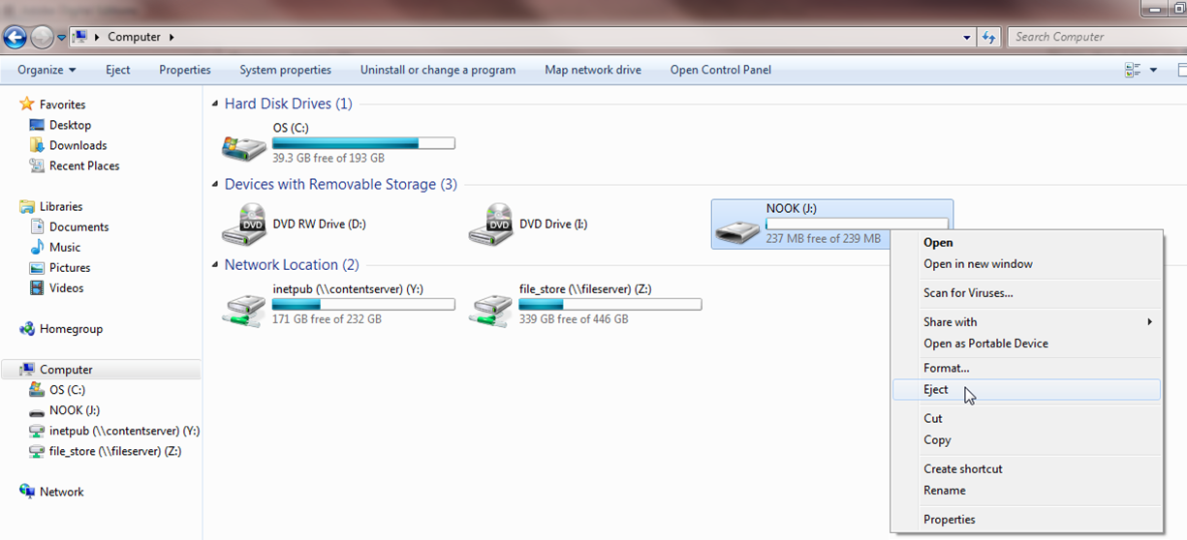
Safely Eject Your Reader
Before your disconnect your Reader, you should Eject it from the computer. Click on the Start Menu and select “Computer”. Then, right-click on the Nook drive and select “Eject”. You can now safely unplug your Reader from the computer.

Slide 32
Managing your Borrowed eBooks
Once you eject your Nook, you will see the title in “Library” on the Nook.
Note that you will no longer be able to view the eBook when its load period expires. However, the eBook will remain on your device.
Should you want to return a book early or remove it from the Nook once it has been returned, all this must be done through Adobe Digital Editions on your computer. The next few slides explain how to do this.

Slide 33
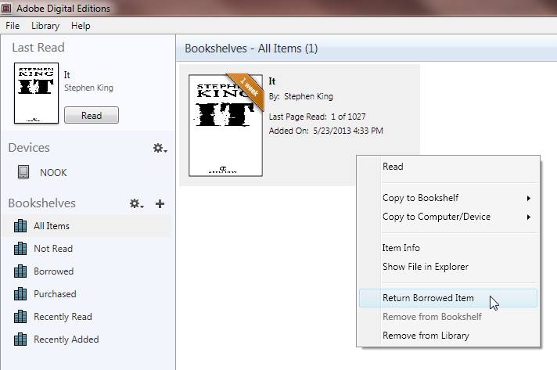
Managing your Borrowed eBooks
To return your book early, open Adobe Digital Editions on your computer and click on the “All Items” bookshelf on the left. Then right-click on the book jacket and select “Return Borrowed Item”.

Slide 34
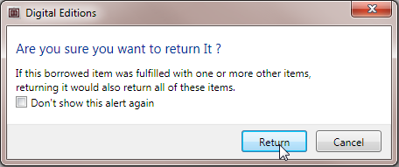
Managing your Borrowed eBooks
A dialog will appear asking if you are sure you want to return it. Click “Return”.

Slide 35
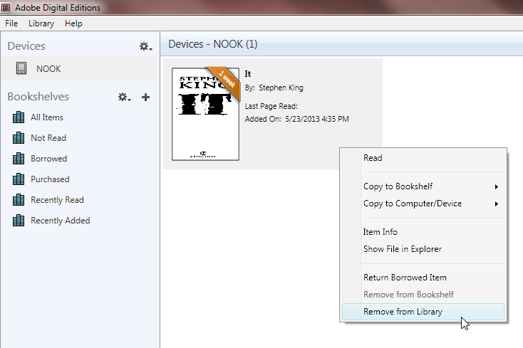
Managing your Borrowed eBooks
To remove a book from your Nook, open ADE, plug your Nook into your computer and select it on the left side. Right-click on the book jacket and select “Remove from Library”.

Slide 36
More eBook Help
For more information on library eBooks and audiobooks, please see our eBook Help page:
www.mc-npl.org/ebook-help

